Slide 1
Contexts of Software Architecture
Md. Iftekharul Alam Efat

Slide 2
Chapter Outline
Architecture in a Technical Context
Architecture in a Project Life-Cycle Context
Architecture in a Business Context
Architecture in a Professional Context
Stakeholders
How Is Architecture Influenced?
What Do Architectures Influence?
Summary

Slide 3
Contexts of Software Architecture
Sometimes we consider software architecture the center of the universe!
Technical
Project life cycle
Business
Professional
What technical role does the software architecture play in the system or systems of which it’s a part?
How does a software architecture relate to the other phases of a software development life cycle?
How does the presence of a software architecture affect an organization’s business environment?
What is the role of a software architect in an organization or a development project?

Slide 4
Technical Context
The most important technical context factor is the set of quality attributes that the architecture can help to achieve
The architecture’s current technical environment is also an important factor
Standard industry practices
Software engineering techniques prevalent in the architect’s professional community
Today’s information systems are web-based, object-oriented, service-oriented, mobility-aware, cloud-based, social-networking-friendly
It wasn’t always so
It won’t be so ten years from now

Slide 5
Project Life-cycle Context
Software development processes are standard approaches for developing software systems
They impose a discipline on software engineers and, more important, teams of software engineers
They tell the members of the team what to do next
There are four dominant software development processes:
Waterfall
Iterative
Agile
Model-driven development

Slide 6
Architecture Activities
All of these processes include design among their obligations
Architecture is a special kind of design, so architecture finds a home in each one
No matter the software development process, there are activities involved in creating a software architecture, using that architecture to realize a complete design, and then implementing or managing the evolution of a target system or application:
Making a business case for the system
Understanding the architecturally significant requirements
Creating or selecting the architecture
Documenting and communicating the architecture
Analyzing or evaluating the architecture
Implementing and testing the system based on the architecture
Ensuring that the implementation conforms to the architecture

Slide 7
Business Context
Architectures and systems are not constructed frivolously
They serve some business purposes
These purposes may change over time

Slide 8
Architecture and Business Goals
Systems are created to satisfy the business goals of one or more organizations
Development organizations want to make a profit, or capture market, or stay in business, or help their customers do their jobs better, or keep their staff gainfully employed, or make their stockholders happy, or a little bit of each
Customers have their own goals for acquiring a system, usually involving some aspect of making their lives easier or more productive. Other organizations involved in a project’s life cycle, such as subcontractors or government regulatory agencies, have their own goals dealing with the system
Architects need to understand who the vested organizations are and what their goals are. Many of these goals will have a profound influence on the architecture

Slide 9
Architecture and Business Goals
Every quality attribute—such as a user-visible response time or platform flexibility or ironclad security or any of a dozen other needs—should originate from some higher purpose that can be described in terms of added value
“Why do you want this system to have a really fast response time?”
This differentiate the product from its competition and let the developing organization capture market share
Some business goals will not show up in the form of requirements
Still other business goals have no effect on the architecture whatsoever
A business goal to lower costs might be realized by asking employees to work from home, or turn the office thermostats down in the winter, or using less paper in the printers

Slide 10
Architecture and business goals

Slide 11
Professional Context
You will perform many duties beyond directly producing an architecture
You will need to be involved in supporting management and dealing with customers
Architects need more than just technical skills.
Architects need to explain to one stakeholder or another the chosen priorities of different properties, and why particular stakeholders are not having all of their expectations fulfilled
Architects need diplomatic, negotiation, and communication skills
Architects need the ability to communicate ideas clearly
You will need to manage a diverse workload and be able to switch contexts frequently
You will need to be a leader in the eyes of developers and management
Architects need up-to-date knowledge.
You will need to know about (for example) patterns, or database platforms, or web services standards
You will need to know business considerations

Slide 12
Stakeholders
A stakeholder is anyone who has a stake in the success of the system
Stakeholders typically have different specific concerns that they wish the system to guarantee or optimize
You will need to know and understand the nature, source, and priority of constraints on the project as early as possible. Therefore, you must identify and actively engage the stakeholders to solicit their needs and expectations
Early engagement of stakeholders allows you to understand the constraints of the task, manage expectations, negotiate priorities, and make tradeoffs

Slide 13
Stakeholders

Slide 14
Stakeholders
Know your stakeholders!
Talk to them, engage them, listen to them, and put yourself in their shoes.

Slide 15
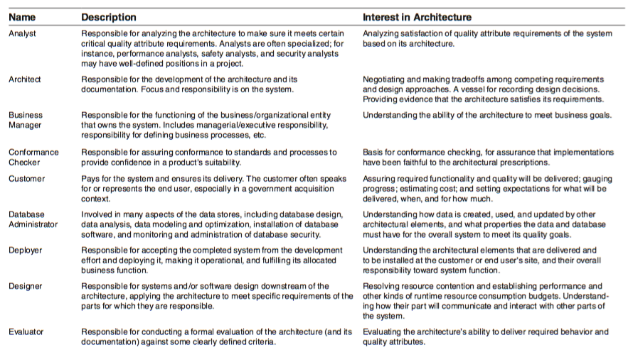
Stakeholders for a System and Their Interests

Slide 16
How is Architecture Influenced?
Requirements influence the architecture, of course
But the requirements specification only begins to tell the story
A software architecture is a result of business and social influences, as well as technical ones
The existence of an architecture in turn affects the technical, business, and social environments that subsequently influence future architectures
In particular, each of the contexts for architecture plays a role in influencing an architect and the architecture

Slide 17
How is Architecture Influenced?

Slide 18
What Do Architectures Influence?
Technical context
The architecture can affect stakeholder requirements for the next system
It gives the customer the opportunity to receive a system (based on the same architecture) in a more reliable, timely, and economical manner than if built from scratch
A customer may in fact be willing to relax some of their requirements to gain these economies
Shrinkwrapped software has clearly affected people’s requirements by providing solutions that are not tailored to any individual’s precise needs but are instead inexpensive and (in the best of all possible worlds) of high quality

Slide 19
What Do Architectures Influence?
Project context
The architecture affects the structure of the developing organization
An architecture prescribes the units of software that must be implemented (or otherwise obtained) and integrated to form the system
These units are the basis for the development project’s structure
Teams are formed for individual software units; and the development, test, and integration activities all revolve around the units
Teams become embedded in the organization’s structure

Slide 20
What Do Architectures Influence?
Business context
The architecture can affect the business goals of the developing organization
A successful system built from an architecture can enable a company to establish a foothold in a particular market segment
The architecture can provide opportunities for the efficient production and deployment of similar systems, and the organization may adjust its goals to take advantage of its newfound expertise to plumb the market

Slide 21
What Do Architectures Influence?
Professional context
The process of system building will affect the architect’s experience with subsequent
A system that was successfully built around a particular technical approach will make the architect more inclined to build systems using the same approach in the future
Architectures that fail are less likely to be chosen for future projects

Slide 22
Architecture Influence Cycle

Slide 23
Summary
Architectures exist in four different contexts
Technical: The technical context includes the achievement of quality attribute requirements
Project life cycle: Regardless of the software development methodology you use, you must perform specific activities
Business: The system created from the architecture must satisfy the business goals of a wide variety of stakeholders
Professional: You must have certain skills and knowledge to be an architect, and there are certain duties that you must perform as an architect
An architecture has influences that lead to its creation, and its existence has an impact on the architect, the organization, and, potentially, the industry
We call this cycle the Architecture Influence Cycle

